Slide 1
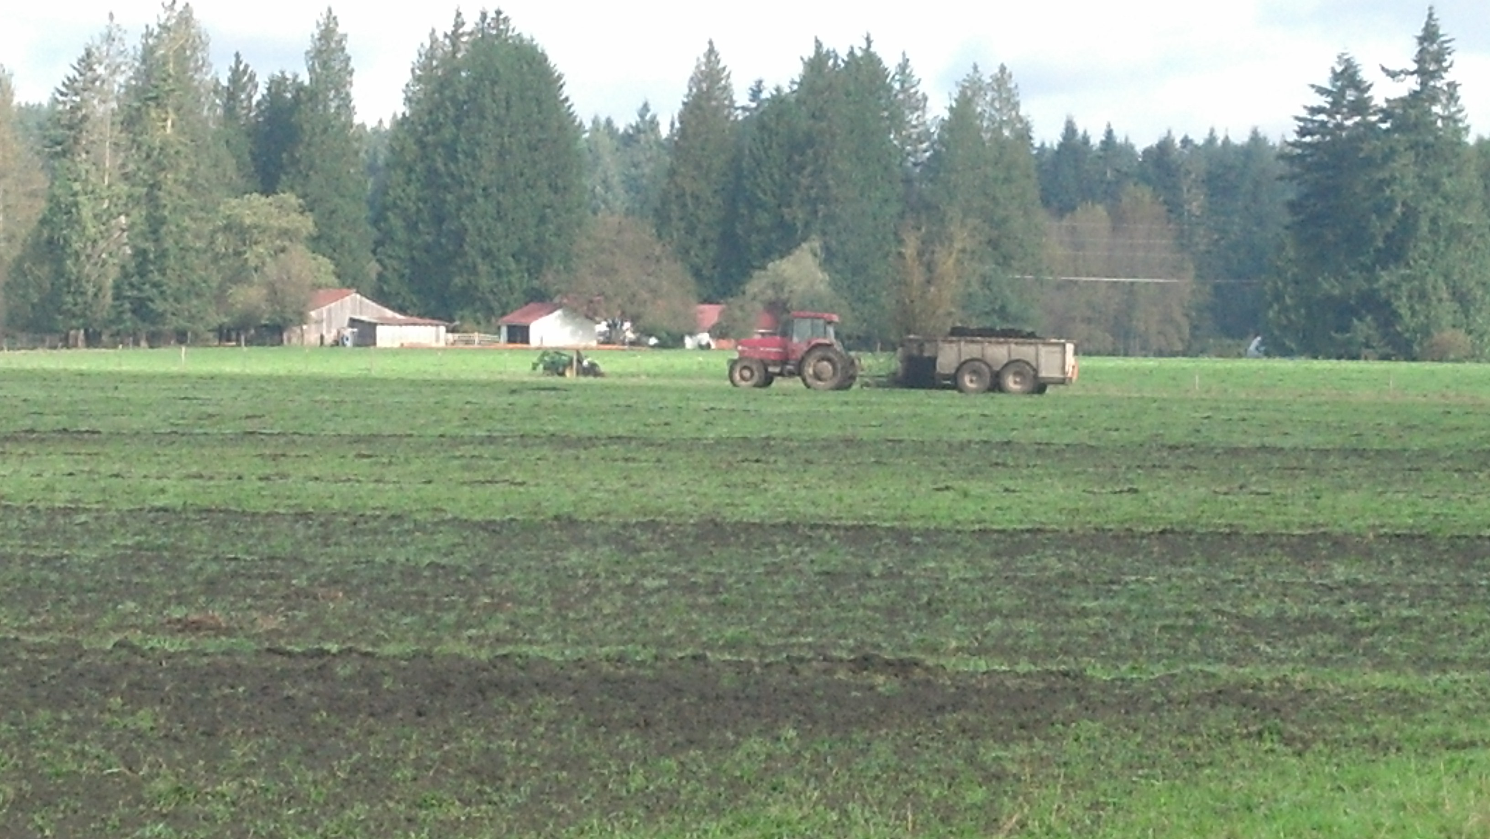
Fire Mountain Farms Biosolids Permitting and Agreed Order
Peter Lyon and Shawnté Greenway
SW Regional Biosolids Coordinator
November 18, 2020

Slide 2
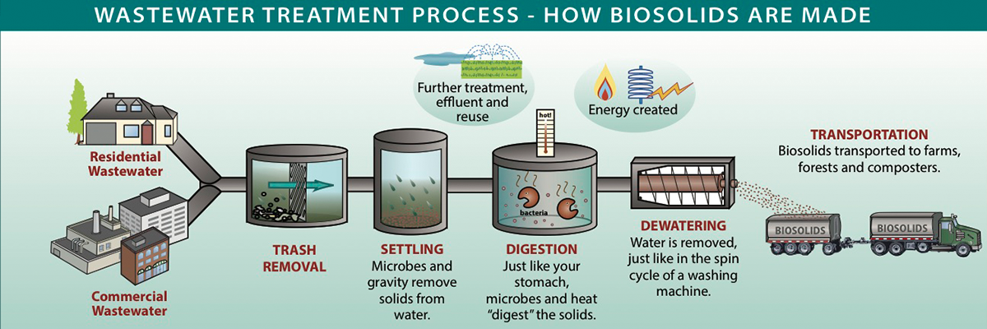
What are Biosolids?

Slide 3
Sludge vs. Biosolids
Sewage Sludge
Solids that have not met state regulatory standards
Biosolids
Treated solids that have met state regulatory standards for land application
Biosolids are treated sewage sludge

Slide 4
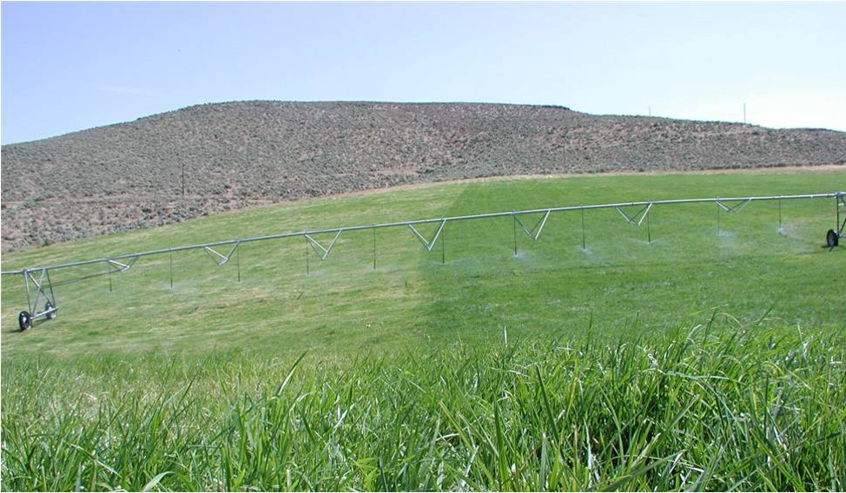
Why are Biosolids Land Applied?
“The legislature declares that a program shall be established to manage municipal sewage sludge and that the program shall, to the maximum extent possible, ensure that municipal sewage sludge is reused as a beneficial commodity and is managed in a manner that minimizes risk to public health and the environment.”

Slide 5
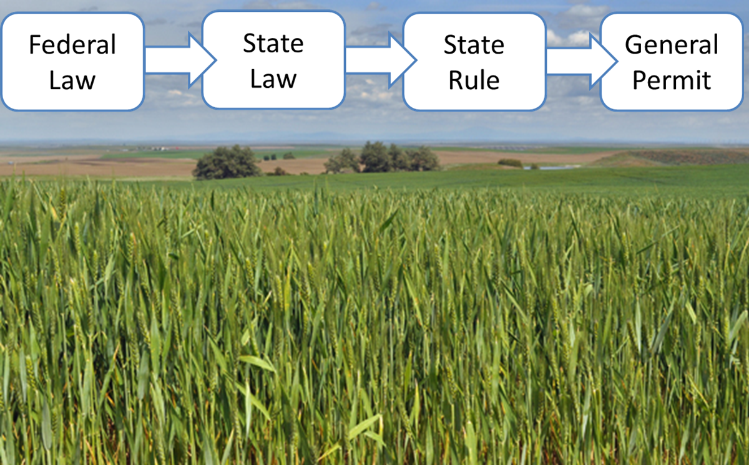
How Does Ecology Regulate Biosolids?

Slide 6
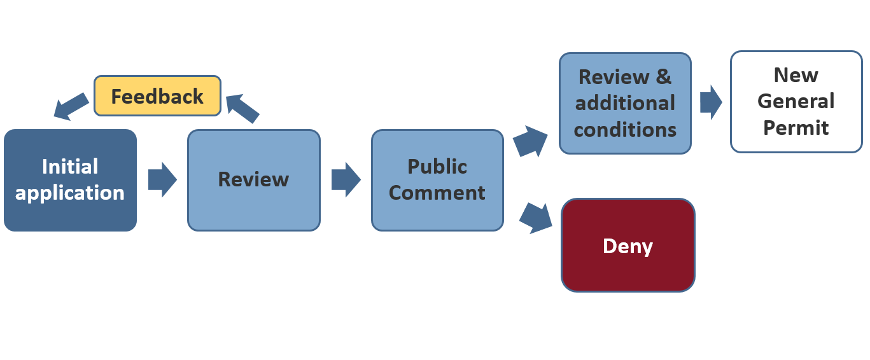
Biosolids Permitting Process

Slide 7

What Does Ecology Regulate?
Pathogen
Insects and Rodents
Pollutants

Slide 8
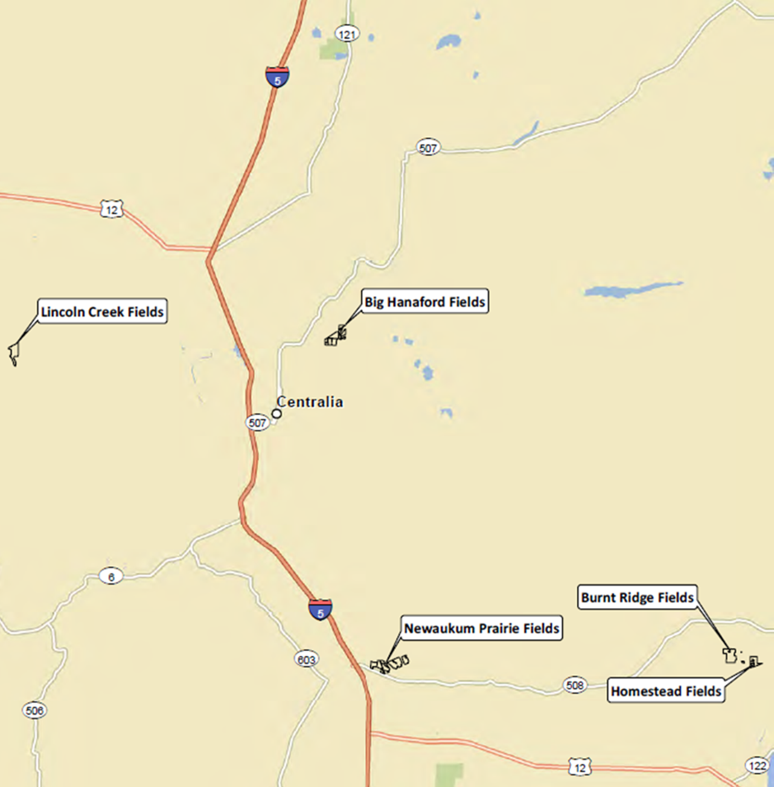
Proposed Sites

Slide 9
Fire Mountain Farms Permit Application
Site Specific Land Application Plans
Maps
Soil Survey
Landowner Agreement
SEPA Determination of Non-Significance
Agreed Order Conditions

Slide 10
Agreed Order
All Lewis County Sites
Staging
Odors
Biosolids Application Management Matrix
Site Specific
See Agreed Order conditions for specific conditions
Notes:
Maybe delete

Slide 11
Biosolids Application Management Matrix
Target (≥15 ppm) | No increase in application rate or decrease in nutrient removal without Ecology consultation
Above Target (>15 ppm - 30 ppm) | Report proposed actions to reduce residual nitrates Ecology may require a reduced application rate up to 25%
Excessively Above Target (>30 ppm) | Explanatory report shall be submitted by professional consultant which includes recommended changes to application and farming practices Ecology may require a reduced application rate up to an additional 25% After three consecutive years in this bracket, stop application until fall soil nitrate returns to target range

Slide 12
Raise your webinar hand and wait to be unmuted
- or –
Type your question in the chat box and we’ll read it
Questions?
Shawnté Greenway, swrobiosolids@ecy.wa.gov, 360-407-6055
Notes:
And with that, I’ll pass it back to Angie for our question and answer session.

Slide 13

Public Hearing
Hearing officer: Angela Fritz
Other ways to send us your comments, due by Dec. 2, 2020
Online
http://wq.ecology.commentinput.com/?id=DQCfZ
Mail
Shawnté Greenway
Department of Ecology
P.O. Box 47775
Olympia, WA 98504-7775

