Slide 1
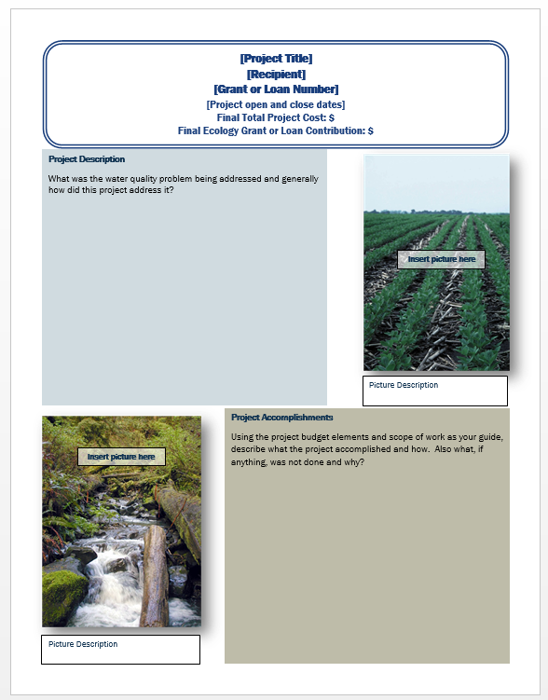
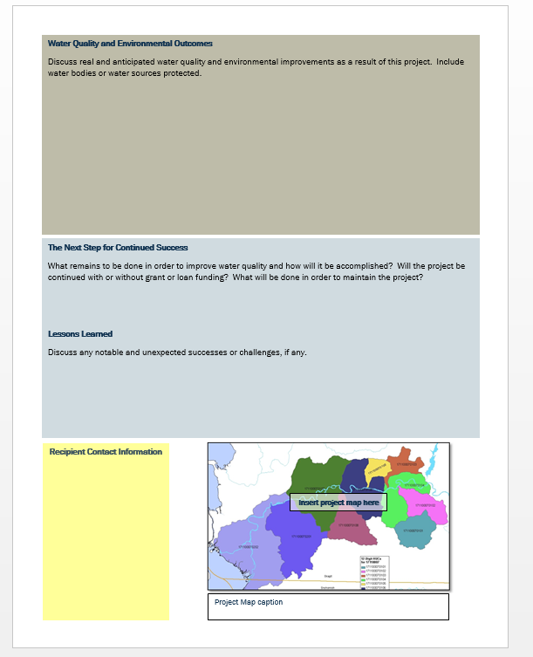
Guidance on the Two-Page Executive Summary for Stormwater Activity Projects
Notes:
-

Slide 2
Purpose of the Two-Page Executive Summary
Completion of the two-page executive summary is a required deliverable in your Scope of Work under the Task 1- Project Administration/ Management section of your agreement.
  -It is also called a Project Outcome Summary Report.
This report is a condensed version of your project and should highlight the successes of your project. It is seen by the legislature to account for funding dollars spent.

Slide 3
Project General Information
[Project Title]
[Recipient]
[Grant Number]
[Project open and close dates]
Final Total Project Cost: $
Ecology Funded Water Quality Improvement Cost: $
Additional Water Quality Improvement Cost: $
Other Project Cost $
Final Total Project Cost- Should be the sum of Ecology Funded Water Quality Improvement Costs, Additional Water Quality Improvement Costs, and Other Project costs.
Ecology Funded Water Quality Improvement Cost- Ecology grant and loan money contributed to the project.
Additional Water Quality Improvement Cost- These are water quality improvement tasks that were not covered by Ecology funding, i.e. if you had a cap on your funding, match portion, unexpected costs covered that were not in the original budget. This amount may be $0 if Ecology paid for all water quality expenses.
Other Project Cost- Other costs associated with the project, i.e. benches, lighting, road paving, etc.
Brackets = fill in the blank (and delete the brackets!)

Slide 4
Project Context and Description
Context and Project Description
[Insert the project short description from your agreement here]
[Is this project associated with a waterbody? If yes, which?]
[Provide a brief narrative to describe why your community needed this water quality project. Describe the pre-project conditions and the water quality problem. Include information related to the problems the project will fix/help fix, such as beach closures, complaints, health hazards, citizen complaints, regulatory compliance issues, newspaper articles, ugly smelly water etc.]
Copy and paste the short description of your agreement here.
Provide a couple sentences of context for your project. What is the motivation behind the project, namely, tell us about the problem?
Brackets = fill in the blank (and delete the brackets!)
Notes:
Purpose: What the project is and why it’s important

Slide 5
Project Accomplishments
Project Accomplishments
In order to improve water quality, the [Name of recipient] implemented:
Activities Implemented:
[total #, type of activity]
[Provide a brief narrative of performance successes (i.e. project completed on schedule and within budget), partnerships, and other benefits.]
Activity Example
Activities Implemented:
150 miles of roadway swept in a year resulting in x tons of solids removed from Yelm Highway.
Education and Outreach: 5 stormwater management workshops hosted at the Lacey community center, with 150 total attendees.
Brackets = fill in the blank (and delete the brackets!)

Slide 6
Water Quality Improvements
Water Quality Improvements
[Is there any media coverage on this project? Are there any improvements to the problem described above? Mention any available evidence.]
[Is this activity a requirement of the NPDES permit? If so, what permit requirement are you meeting?]
[What future outcomes do you hope to see from the project?]
What water quality improvements do you anticipate?
(i.e. How will behavior change improve WQ? How will equipment like sweepers/vactor trucks be used in the future to improve WQ? Anticipated miles swept/catch basins cleaned?)
Brackets = fill in the blank (and delete the brackets!)

Slide 7
Next Steps & Lessons Learned
Lessons Learned
[Discuss any notable or unexpected successes or challenges.]
The Next Step for Continued Success
[Is there more work to be done to complete this project? If so, what is the estimated time frame and will the project be continued with or without Ecology funding? If applicable, what operations and maintenance tasks will be performed and who will be performing them?]
Highlight operation and maintenance tasks and who will perform them. Talk about other phases of this project if applicable.
Brackets = fill in the blank (and delete the brackets!)

Slide 8
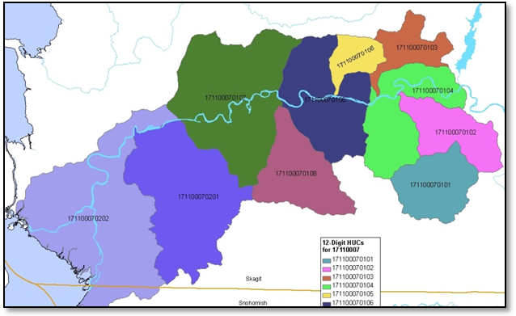
Recipient Contact Information
Recipient Contact Information
Project web page found [here]
Provide the project web page. If none is available, delete this portion.
Project Map caption

Slide 9
Don’t Forget to Check!
Tense
Format
Accuracy
Typos, grammar, spelling
Delete original questions
Fill in the blanks are complete, delete brackets
Quality of project pictures (see next slide for tips)

Slide 10
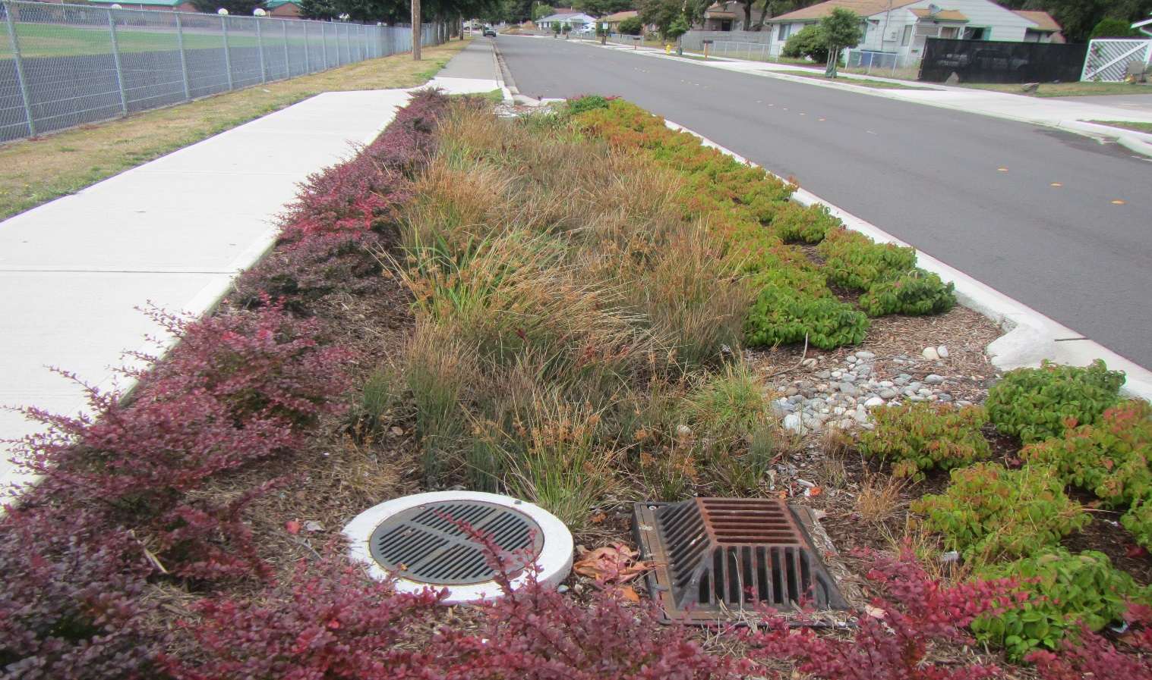
Basic Tips for Taking Good Project Photos
Before and after: Choose a photo point to take before and after from same perspective, avoid using the zoom
Sun: Ideally is behind you, or to the side. Not in front of you.
Shadow: Make sure your focal point is in the light
People: for scale, interest and jobs being performed.
A useful photo is: Attractive
Colorful
In focus

