Slide 1
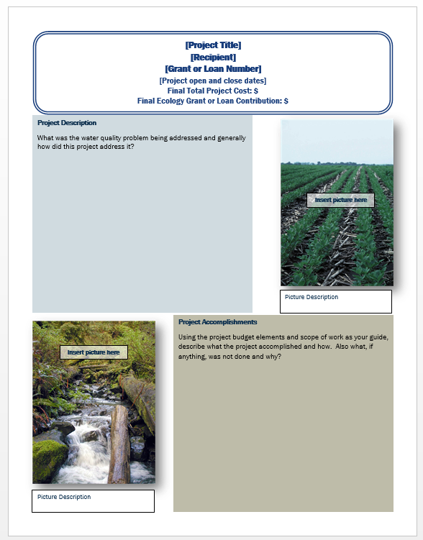
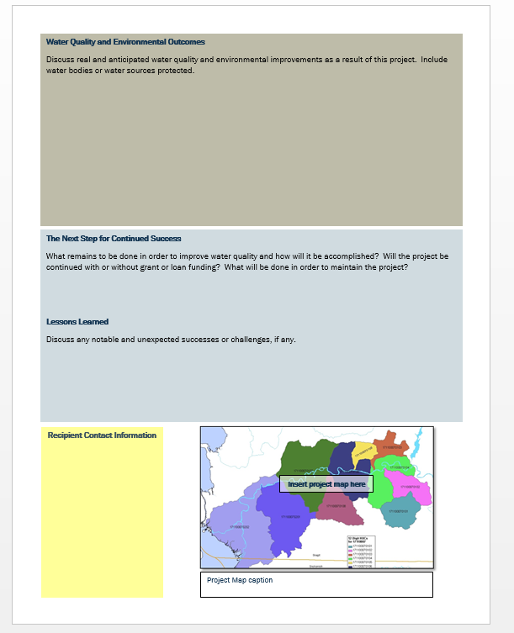
Guidance on the Two-Page Executive Summary for Stormwater Facility Projects
Notes:
-

Slide 2
Purpose of the Two-Page Executive Summary
Completion of the two-page executive summary is a required deliverable in your Scope of Work under the Task 1- Project Administration/ Management section of your agreement.
-It is also called a Project Outcome Summary Report.
This report is a condensed version of your project and should highlight the successes of your project. It is seen by the legislature to account for funding dollars spent.

Slide 3
Project General Information
[Project Title]
[Recipient]
[Grant Number]
[Project open and close dates]
Final Total Project Cost: $
Ecology Funded Water Quality Improvement Cost: $
Additional Water Quality Improvement Cost: $
Other Project Cost $
Final Total Project Cost- Should be the sum of Ecology Funded Water Quality Improvement Costs, Additional Water Quality Improvement Costs, and Other Project costs.
Ecology Funded Water Quality Improvement Cost- Ecology grant and loan money contributed to the project.
Additional Water Quality Improvement Cost- These are water quality improvement tasks that were not covered by Ecology funding, i.e. if you had a cap on your funding, match portion, unexpected costs covered that were not in the original budget. This amount may be $0 if Ecology paid for all water quality expenses.
Other Project Cost- Other costs associated with the project, i.e. benches, lighting, road paving, etc.
Brackets = fill in the blank (and delete the brackets!)

Slide 4
Project Context and Description
Context and Project Description
[This project improves water quality in the (Name Of Waterbody) through the installation of (Type Of Water Quality Facilities) at (Project Location) in the (City/County) of (Name). This project provides treatment for (Total Suspended Solids (TSS), Oil (Total Petroleum Hydrocarbons), Dissolved Copper, Dissolved zinc, and Total Phosphorus) and also reduces flows to (Water Body Name) by increasing stormwater infiltration and /or providing stormwater detention. Additional benefits of this project include (list).]
[Provide a brief narrative to describe why your community needed this water quality project. Describe the pre-project conditions and the water quality problem. Include information related to the problems the project will fix/help fix such as beach closures, complaints, health hazards, citizen complaints, regulatory compliance issues, newspaper articles, ugly smelly water etc.]
Copy and paste the short description of your agreement here or fill in the highlighted portions.
Provide a couple sentences of context for your project. What is the motivation behind the project, namely, tell us about the problem?
Brackets = fill in the blank (and delete the brackets!)
Notes:
Purpose: What the project is and why it’s important

Slide 5
Project Accomplishments
Project Accomplishments
In order to improve water quality, the [Name of recipient] installed:
Facilities Designed and/ or Constructed:
[#, Type]
Basin Area: [total acres draining to these facilities], [land use type].
These [BMPS] provide [flow control, source control, treatment].
[Provide a brief narrative of performance successes (i.e. project completed on schedule and within budget), partnerships, and other benefits.]
Facility Example
Facilities Constructed:
5,000 sq ft. of Pervious Concrete installed.
5 new 2-stage drywells installed.
Basin Area: These facilities control runoff from 6 acres in a single-family residential area.
Brackets = fill in the blank (and delete the brackets!)

Slide 6
Water Quality Improvements
Water Quality Improvements
Evaluating water quality benefits from retrofit projects can be challenging. Often, the existing built environment does not have enough undeveloped land left to build BMPs that would be sufficient to effectively manage all the stormwater generated by the drainage basin. In the retrofit program, Ecology encourages local communities to build the largest facility that will fit in the available space and then uses a calculation that was developed with stakeholder input to evaluate the amount of treatment and flow control provided in retrofit projects on a common basis for reporting purposes. Ecology calls this area the runoff treatment or flow control equivalent area.
Using this equivalent area, we can estimate the amount of solids removal per year that the project can achieve, using a given amount of pollutant removal and the annual runoff. We can also estimate the area that has runoff similar to pre-developed conditions created through the retrofit project.
The following table lists the equivalent area values for this project:
[Is there any media coverage on this project? Are there any improvements to the problem described above? Mention any available evidence.]
Leave this standardized language and table here.
See next slide for table instructions.
 | Runoff Treatment |  | Flow Control
Actual Basin Area (ac) | Equivalent Area (ac) | Solids removed per year (lbs.) | Equivalent Area (ac)
Brackets = fill in the blank (and delete the brackets!)

Slide 7
Water Quality Improvements
 | Runoff Treatment |  | Flow Control
Actual Basin Area (ac) | Equivalent Area (ac) | Solids removed per year (lbs.) | Equivalent Area (ac)
Ecology’s Project Manager will calculate this number and fill in the box.
These numbers were required in your design report. Otherwise, instructions on how to calculate the equivalent areas are in the “Design Deliverables for Stormwater Projects with Ecology Funding” document- Appendix D, found at http://www.ecy.wa.gov/programs/wq/funding/Res/Forms/SWDesignDeliv090116.pdf)

Slide 8
Next Steps & Lessons Learned
Lessons Learned
[Discuss any notable or unexpected successes or challenges.]
The Next Step for Continued Success
[Is there more work to be done to complete this project? If so, what is the estimated time frame and will the project be continued with or without Ecology funding? What operations and maintenance tasks will be performed and who will be performing them?]
Highlight operation and maintenance tasks and who will perform them. Talk about other phases of this project if applicable.
Brackets = fill in the blank (and delete the brackets!)

Slide 9
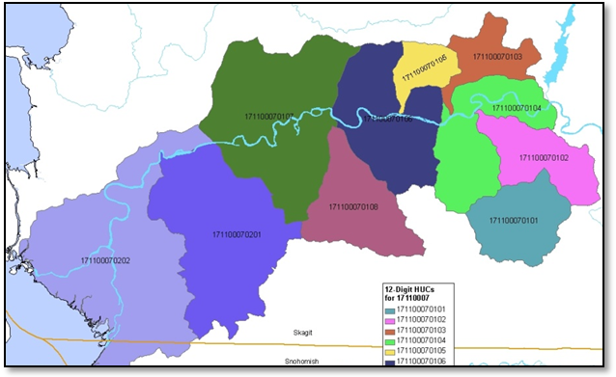
Recipient Contact Information
Recipient Contact Information
Project web page found [here]
Provide the project web page. If none is available, delete this portion.
Project Map caption

Slide 10
Don’t Forget to Check!
Tense
Format
Accuracy
Typos, grammar, spelling
Delete original questions
Fill in the blanks are complete, delete brackets
Quality of project pictures (see next slide for tips)

Slide 11
Basic Tips for Taking Good Project Photos
Before and after: Choose a photo point to take before and after from same perspective, avoid using the zoom
Sun: Ideally is behind you, or to the side. Not in front of you.
Shadow: Make sure your focal point is in the light
People: for scale, interest and jobs being performed.
A useful photo is: Attractive
Colorful
In focus

