Slide 1
Using Arc Reader to Locate
12-Digit HUCs

Slide 2
Contents
Chapter 1: Downloading and Installing ArcReader and Maps: Slide 3
Chapter 2: Locating the 12-Digit HUC by Zooming in on BMP Project Area: Slide 8
Chapter 3: Determining BMP Latitude and Longitude using Google Maps: Slide 13
Chapter 4: Locating the 12-Digit HUC in ArcReader using Latitude and Longitude:
Slide 18

Slide 3
Downloading and Installing ArcReader and Maps
Chapter 1

Slide 4
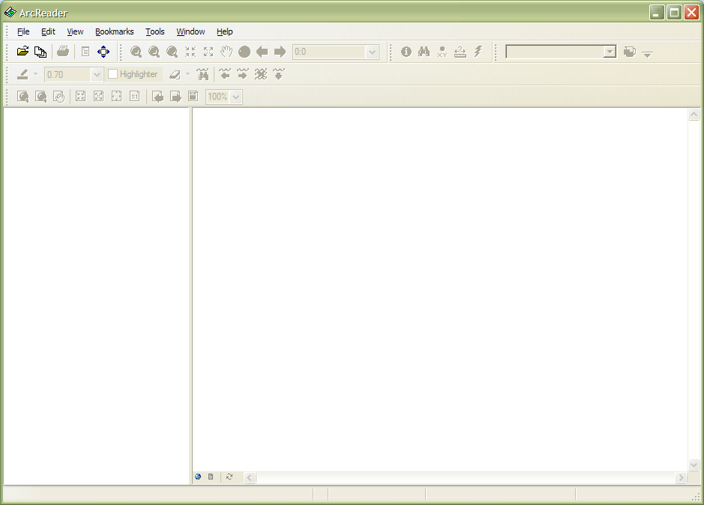
Download and install the most current version of ArcReader (free program): http://www.esri.com/software/arcgis/arcreader/download.html
Save file: 12-Digit HUCs by WRIA.pmf (provided by your financial manager or downloaded from the load reduction website) somewhere on your computer where you can find it easily.
Open ArcReader. The window should look like the picture below.

Slide 5
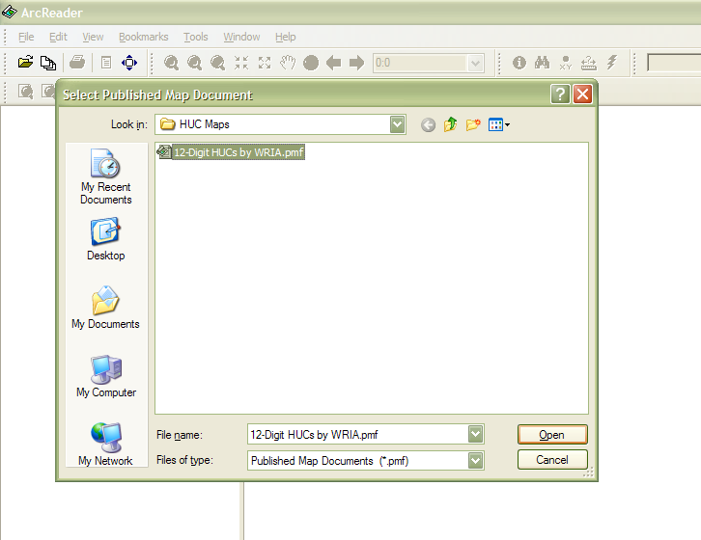
Open the file 12-Digit HUCs by WRIA.pmf in ArcReader.

Slide 6
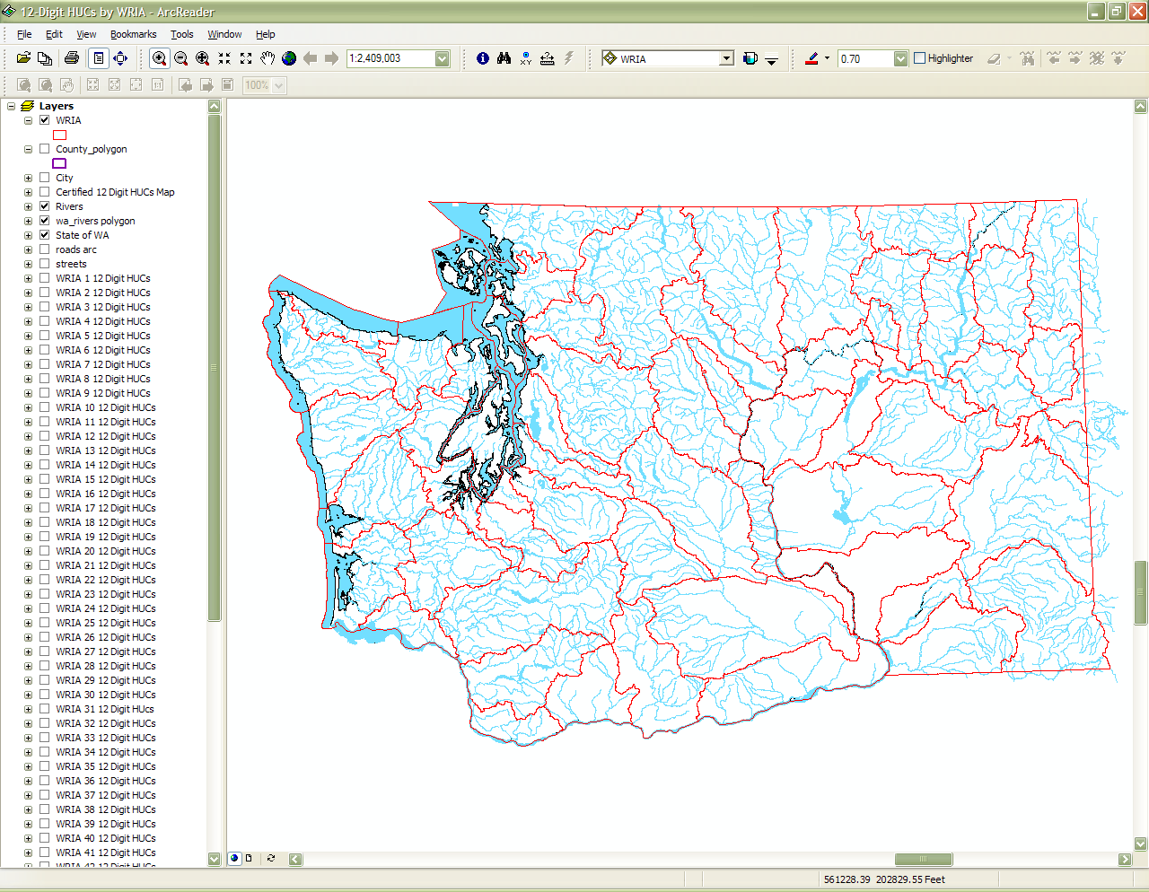
When you open the file you should see a map of the state of Washington

Slide 7
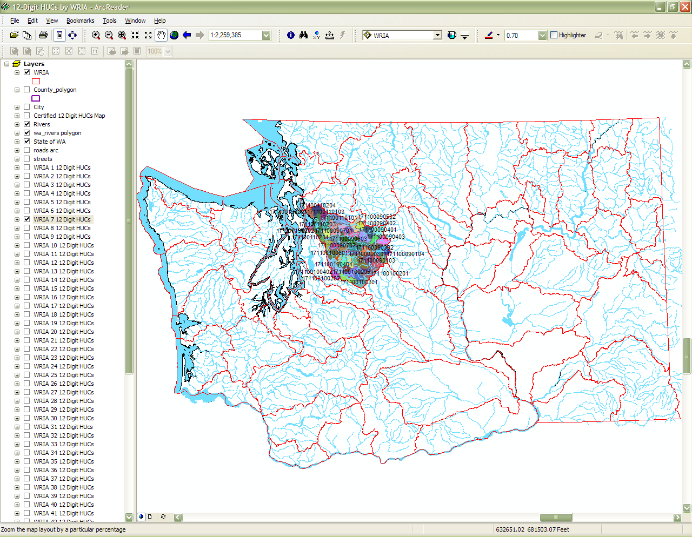
Check or uncheck boxes in the list on the left side of the page to turn features on or off.
Find the WRIA in the list that corresponds to the project and check the box to turn on the feature.

Slide 8
Locating the 12-Digit HUC by Zooming in on BMP Project Area
Chapter 2

Slide 9
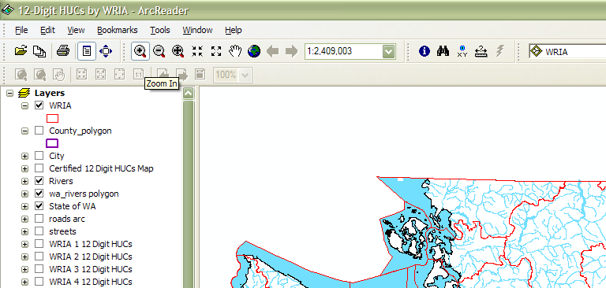
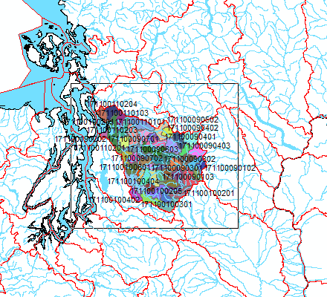
Zoom in by clicking on the magnifying glass in the tool and then dragging a box around the HUC that has been selected.

Slide 10
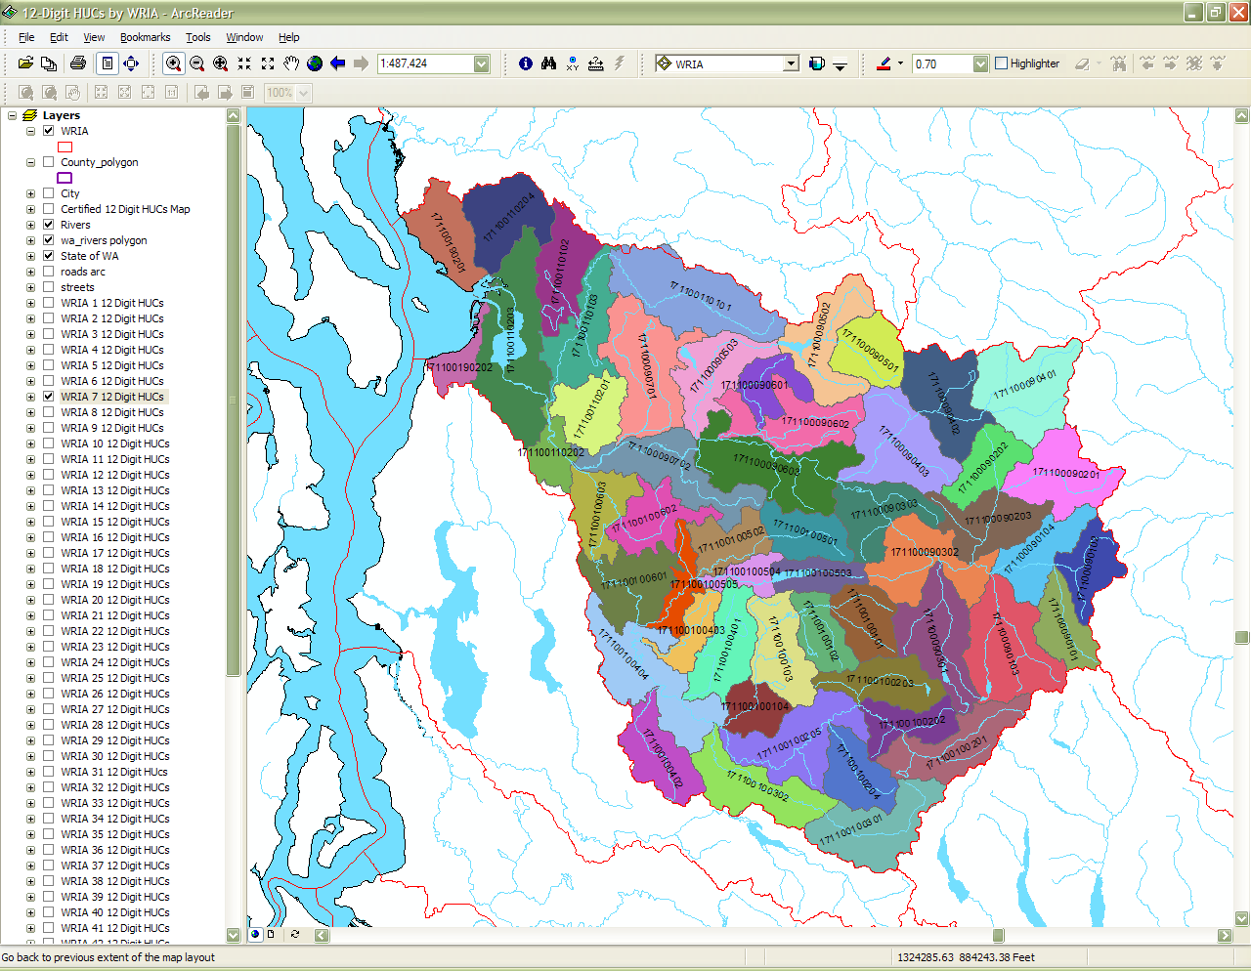
If more information is needed to determine the 12-Digit HUC number or other information about any of the features on the map you may use the Identify tool.

Slide 11
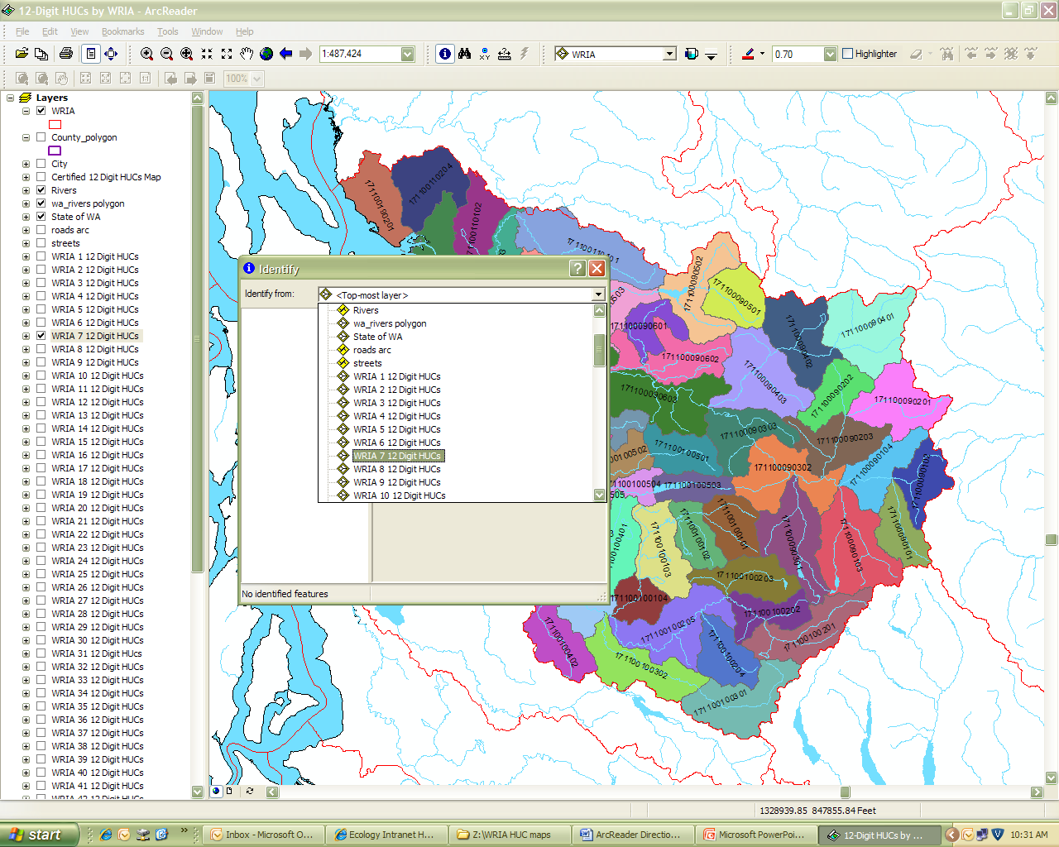
Click on Identify in the toolbar.
Open the pull-down menu to select the feature which you would like more information.

Slide 12
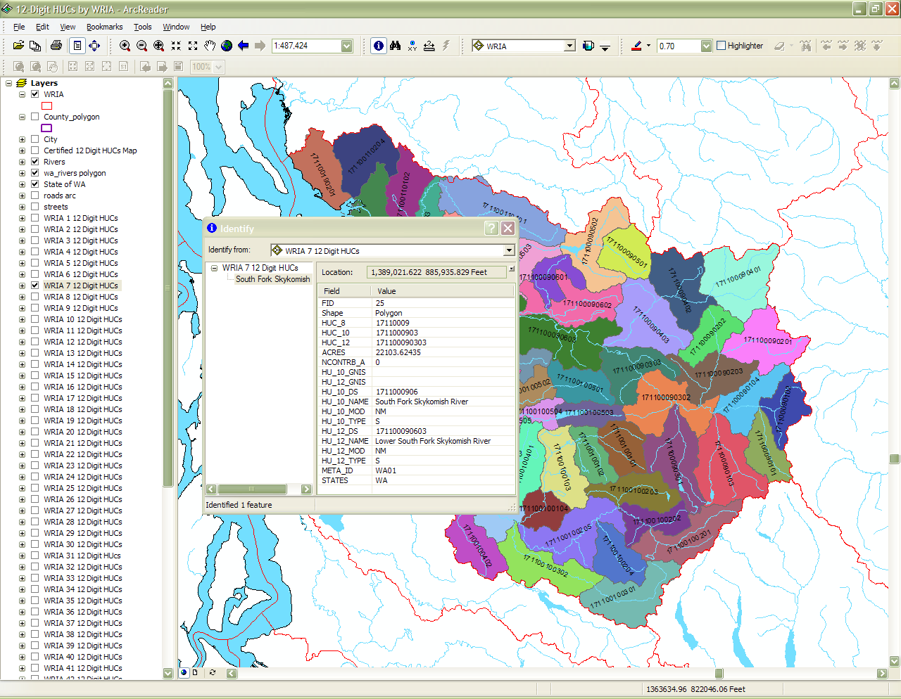
Click on the item of interest. The identify box will show all associated information for that item.
The name of the sub-watershed and HUC are listed in this box.

Slide 13
Determining BMP Latitude and Longitude using Google Maps
Chapter 3

Slide 14
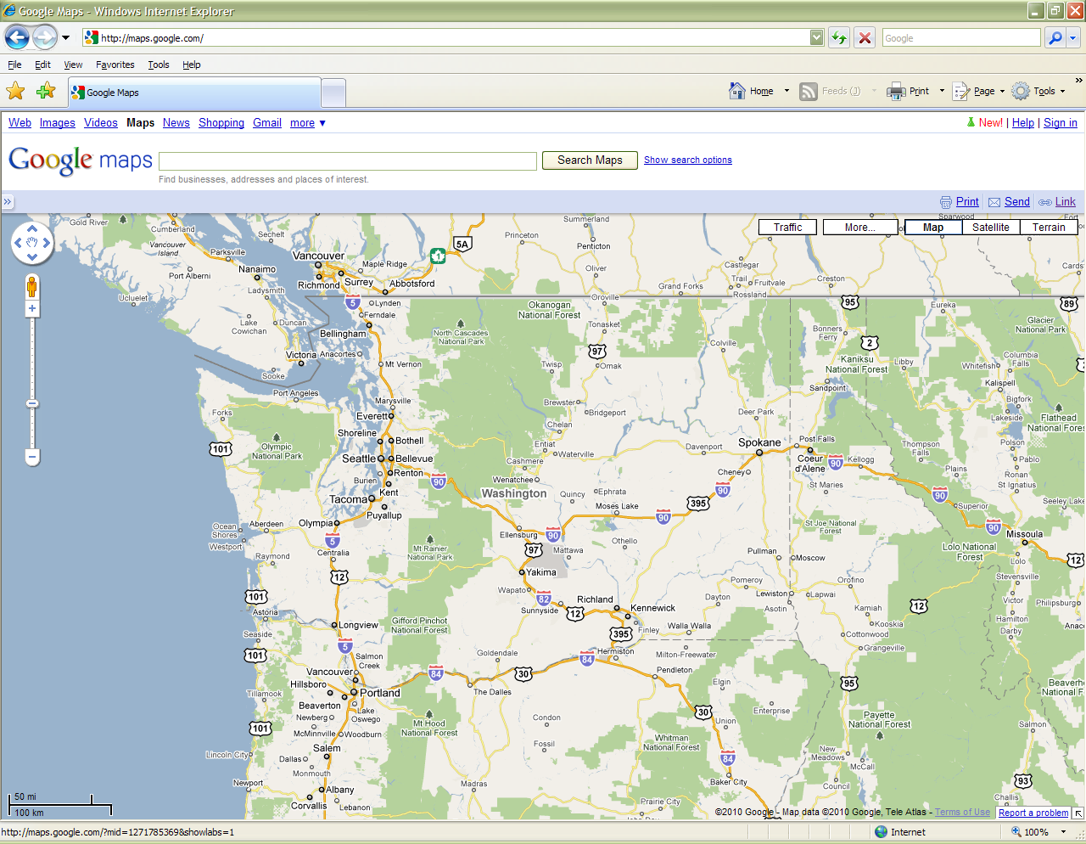
Find latitude and longitude of installed BMPs using Google Maps
Go to http://maps.google.com/maps
In the top right corner click “New”

Slide 15
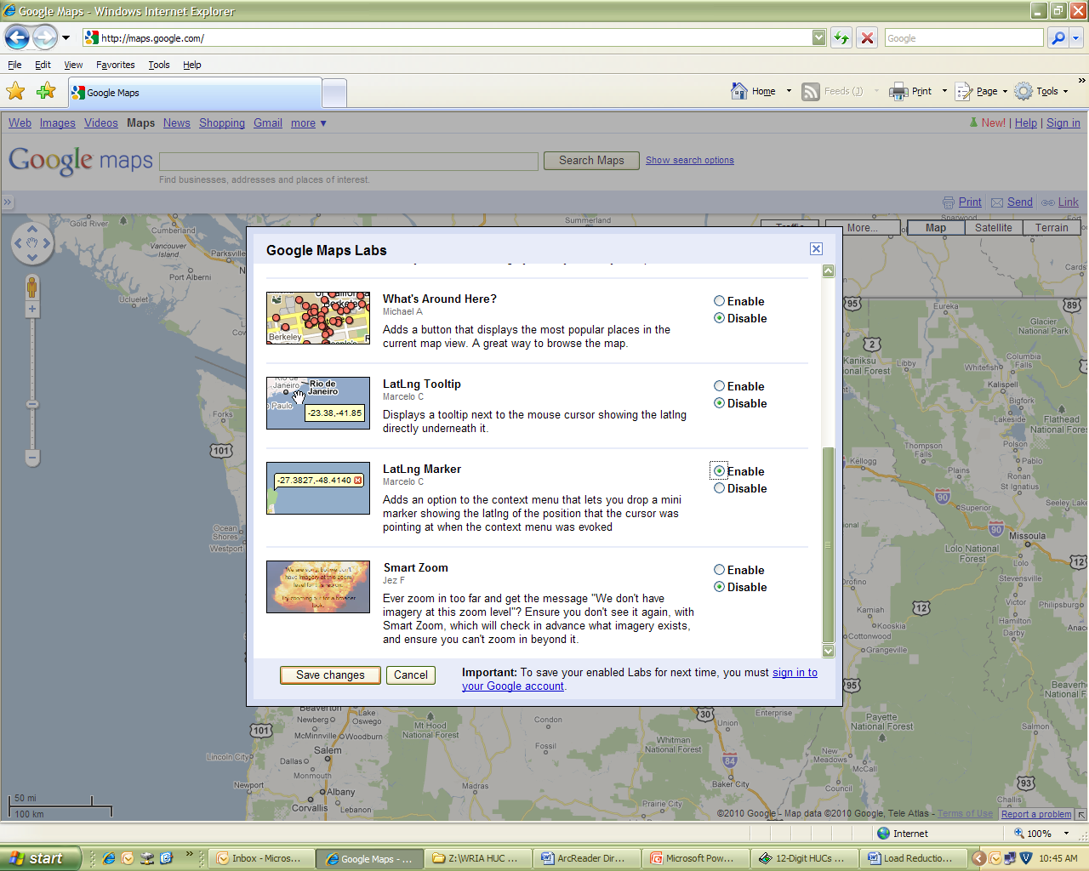
Scroll down to LatLng Marker and click “enable,” then at the bottom click “Save changes.”

Slide 16
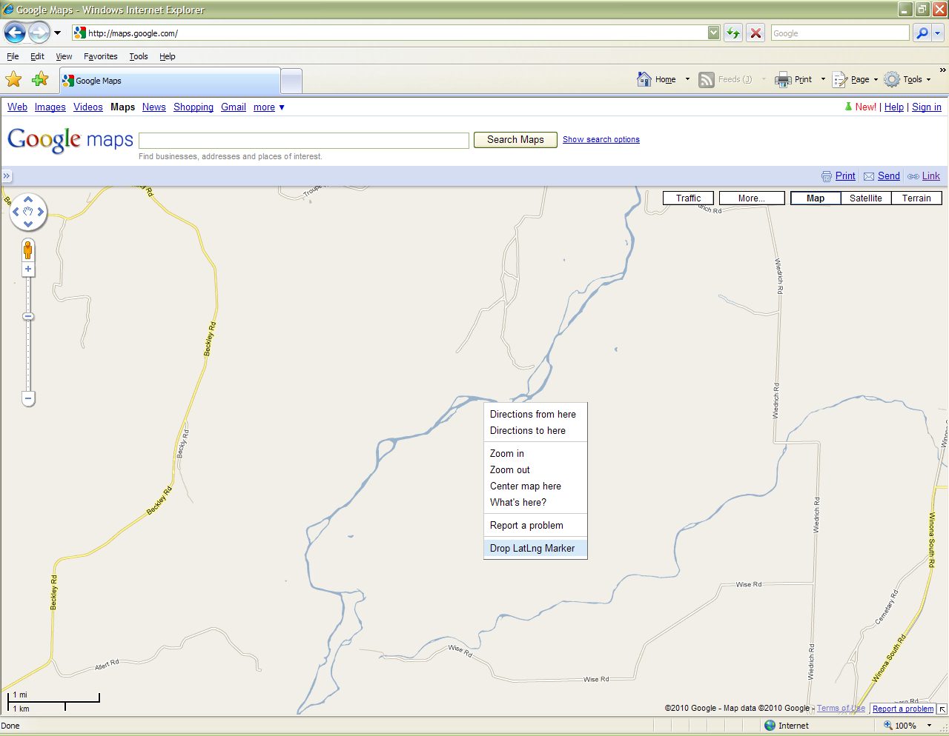
Navigate on the map to where the BMP was installed.
Put the mouse over the area where the BMP is located and right click.
Select “drop LatLng Marker.”

Slide 17
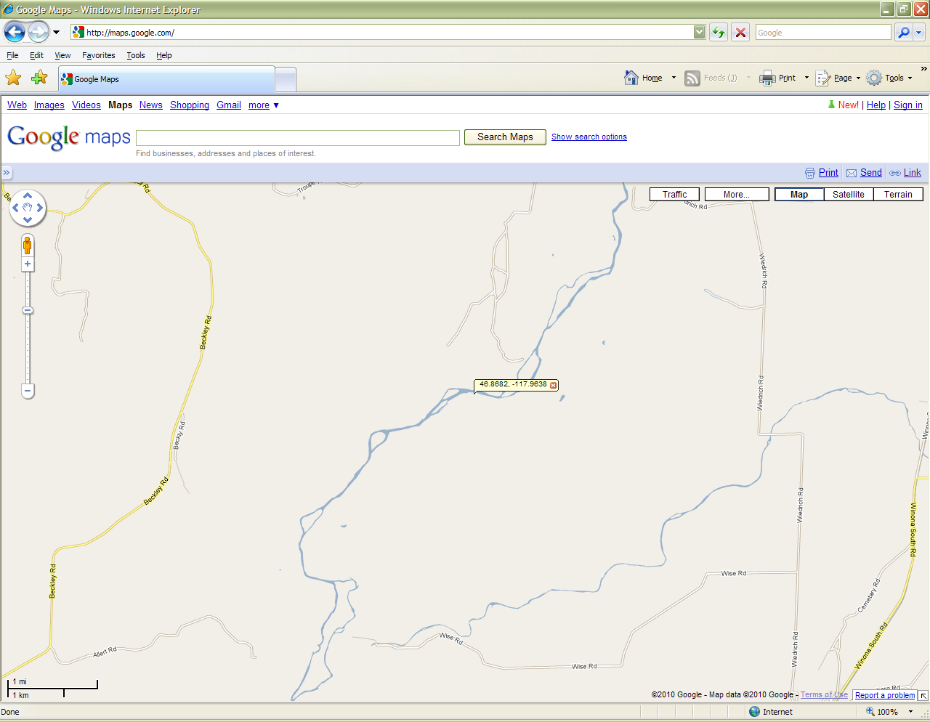
Transfer the numbers that appear on the map into ArcReader.

Slide 18
Locating the 12-Digit HUC in ArcReader using Latitude and Longitude
Chapter 4

Slide 19
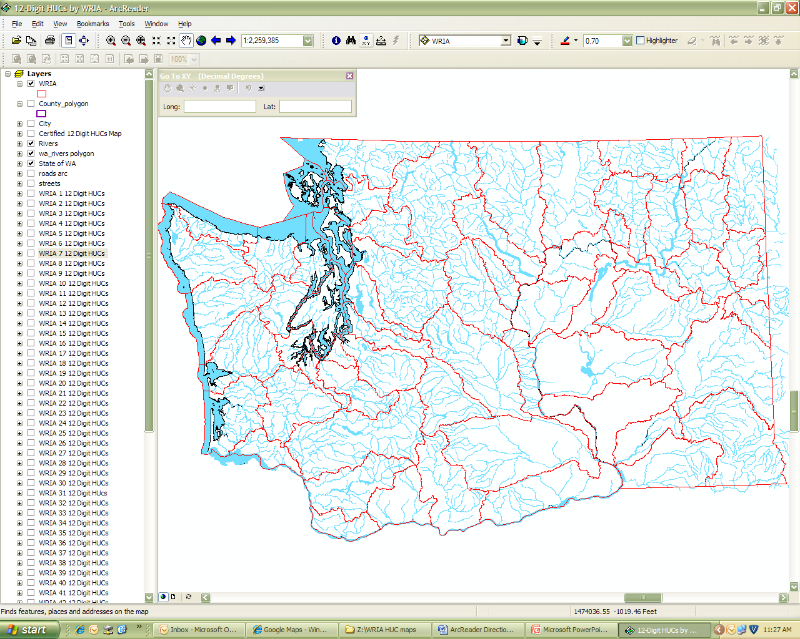
In ArcReader, select the XY button. A box will appear in the top left corner of the map.

Slide 20
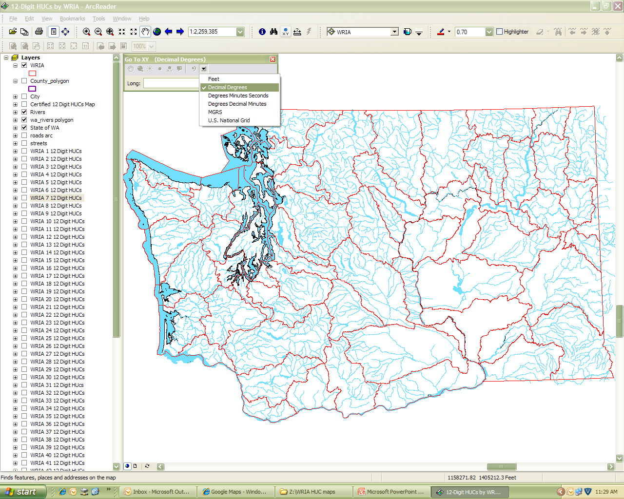
Click on the down arrow in the Go To XY box and select the appropriate format for your measurements. For latitude and longitude from Google Maps, select decimal degrees.

Slide 21
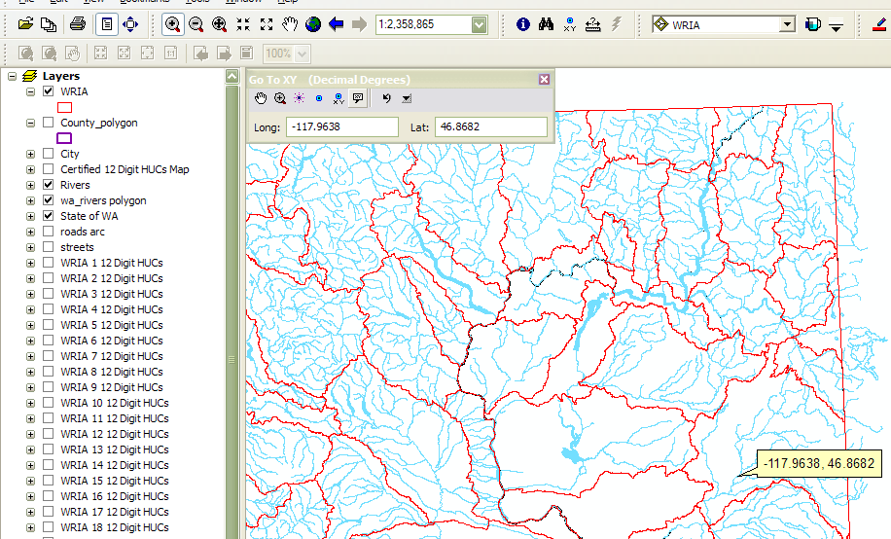
Enter the measurements from Google Maps into the Go To XY box. Remember longitude should be entered first and is a negative number.
Hit enter when you are done entering the number. The map should move to the location. Use one of the options in the Go To XY box to mark the location.
add callout
drag map
add point and label
zoom
add point
flash point

Slide 22
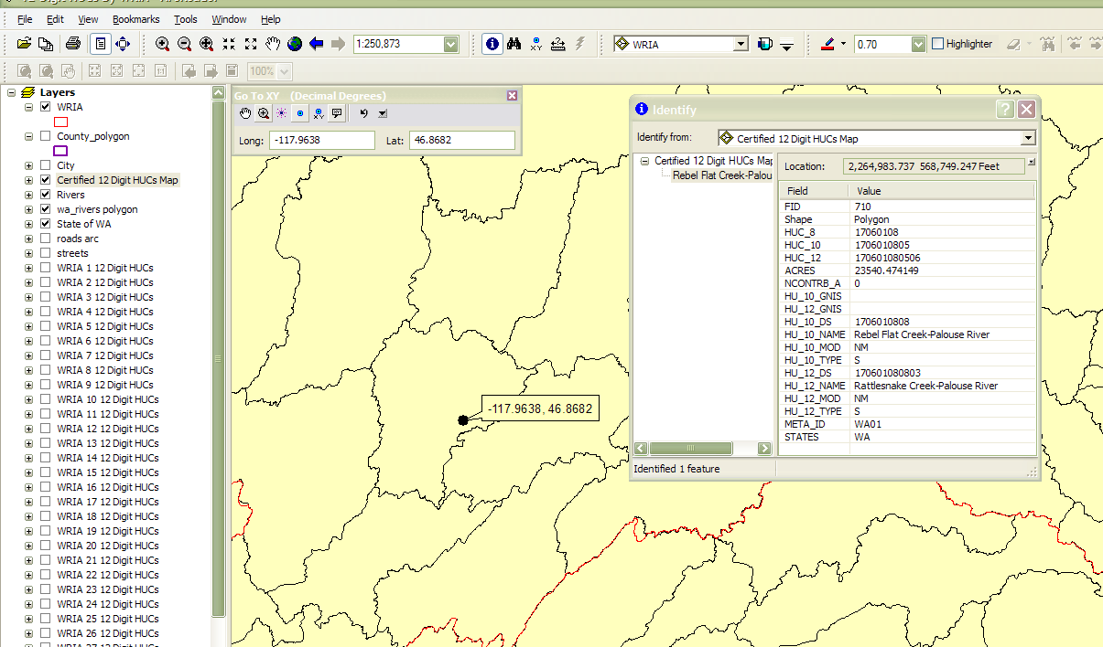
Zoom in closer to the location of the point.
Check the box next to “Certified 12 Digit HUCs map” to turn on that layer.
Using the Identify tool (see Zooming in to Find the BMP section for instructions), select the Certified 12 Digit HUCs Map as the selectable layer, and click on the sub-watershed where the identified BMP is located.
Get information on 12-digit HUC that is listed in the Identify box.

